Slide 1
Recitation 5
Mini Lecture

Slide 2
Announcements
Midterm will be the week of Oct. 24th during recitation session (80 min)
Topics will be covered
1) Data types AND Operation
2) Writing and calling functions
3) Conditional Statements
4) Strings and Arrays
5) Loops
Extra Credit = 2.5 pts on your hw grading (Will be updated before exams)

Slide 3
Outline
Part 1: Reviews (Array && Loop)
Part 2: Problem #1 – Fibonacci sequence
Part 3: Problem #2 – ShearForce & TensileForce

Slide 4
Arrays – A new type of data
Arrays
Arrays:Numbers :: Strings:Characters
You may also hear arrays called “vectors”
Arrays store:
The value of numbers
In a specific sequence
In an orientation, either “vertical” or “horizontal”
In MATLAB, we can:
Create arrays
Set the values of specific numbers within an array
Get the values of specific numbers within an array

Slide 5
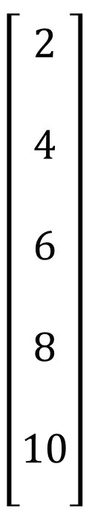

Arrays as you may have seen them before
Arrays
Vertical Array
$$\left[\begin{aligned} \\ 2 \\ \\ 4 \\ \\ 6 \\ \\ 8 \\ \\ 10 \\ \end{aligned}\right]$$
Horizontal Array
$$\left[1 2 3 4 5 6 7\right]$$

Slide 6
Arrays in MATLAB
Arrays
Vertical Array
$$\left[\begin{aligned} \\ 2 \\ \\ 4 \\ \\ 6 \\ \\ 8 \\ \\ 10 \\ \end{aligned}\right]$$
Horizontal Array
MATLAB Syntax:
myArray = [1;2;3;4;5;6;7];
$$\left[1 2 3 4 5 6 7\right]$$
MATLAB Syntax: myArray = [1 2 3 4 5 6 7];
Or: myArray = [1,2,3,4,5,6,7];

Slide 7
Arrays in MATLAB: Creating an Array
Arrays
x = [1 2 3 4 5 6 7]; %You can enter every value yourself
Sometimes that isn’t practical
What if you want an array that’s 1000 numbers long?
x = [1:1000];
x = [1:1:1000];
y = [1:0.5:5];
y = [1 1.5 2 2.5 3 3.5 4 4.5 5];
This reads: “An array from 1 to 1000, counting by 1;
Same Thing
This reads: “An array from 1 to 1000, counting by 1;
This reads: “An array from 1 to 5 counting by 0.5;
Same Thing

Slide 8
Arrays in MATLAB: Creating an Array
Arrays
Key symbols in syntax:
[] %Square brackets denote the beginning and end of the array
[a:b] %A single colon “counts” between the two numbers by increments of 1
[a:c:b] %A number between two colons “counts” between the two numbers by c
Note that the first number will always be “a,” but the last number will be the closest number to “b” you can count to without going over
[1:2:6] == [1 3 5]
[1 4 6] == [1,4,6] %You can use spaces or commas to separate numbers in a “horizontal” array
[1;4;6] %You use semicolons to separate numbers in a “vertical array”
[1;4;6] == [1 4 6]’; %You can “rotate” an array using an apostrophe

Slide 9
Addressing individual numbers in an array
Arrays
We call these the “elements” of the array
We start counting these elements at “1”
MATLAB is weird, almost every other programming language starts at “0”
These rules work the same for vertical and horizontal arrays
array = [2 4 6 8 10 9];
1 2 3 4 5 6
array(3) = 6
array(6) = 9
array(length(array))=?
6 Elements in array
help length

Slide 10
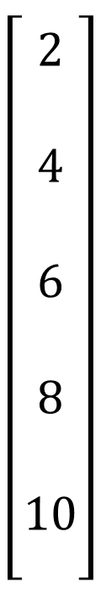
Addressing individual numbers in an array
Arrays
We call these the “elements” of the array
We start counting these elements at “1”
MATLAB is weird, almost every other programming language starts at “0”
These rules work the same for vertical and horizontal arrays
x = [2 4 6 8 10]’;
x(1)
x(3)
$$\left[\begin{aligned} \\ 2 \\ \\ 4 \\ \\ 6 \\ \\ 8 \\ \\ 10 \\ \end{aligned}\right]$$

Slide 11
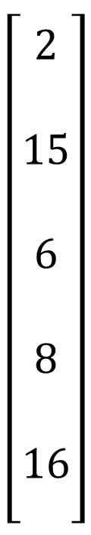
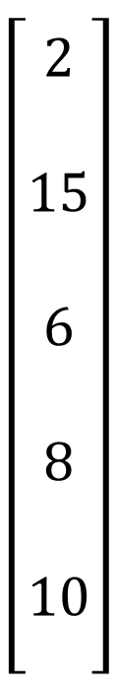
Addressing individual numbers in an array
Arrays
You can treat the elements of arrays like you would any other number variable
Give them a value:
x(2) = 15;
Use them in an equation
x(5) = x(1)*x(4);
You can also create arrays of Booleans
x = [1 0 1 0 1 1 1 0 1 0]; %Remind you of anything? ☺
$$\left[\begin{aligned} \\ 2 \\ \\ 4 \\ \\ 6 \\ \\ 8 \\ \\ 10 \\ \end{aligned}\right]$$
$$\left[\begin{aligned} \\ 2 \\ \\ 15 \\ \\ 6 \\ \\ 8 \\ \\ 10 \\ \end{aligned}\right]$$
$$\left[\begin{aligned} \\ 2 \\ \\ 15 \\ \\ 6 \\ \\ 8 \\ \\ 16 \\ \end{aligned}\right]$$

Slide 12
Loops
Loops
Some things bear repeating
Loops give us rules and structures for repeating commands as many times as we need to

Slide 13
while loops
Loops
Repeat a set of commands so long as some logical statement is true
while x<20
y = x*1;
x = x + 1;
end
Statement resulting in a Boolean
If the Boolean is always true, it will keep running infinitely
ANY code you want to repeat
- Conditional statements
End things to be repeated
- Call functions
- Create variables
- Do calculations
Useful for loops: You can use a variable in an equation and assign the resulting value to the same value (i.e. counting how many times you have gone through the loop)
- Other loops

Slide 14
for loops
Loops
Repeat something a predetermined number of times
Has built in counting variable!
for counter = 1:1:20
y(counter) = counter*10;
end
Creates a variable “counter”
- Starts at 1
- Counts by 1
- Stops at 20
- Follows same counting rules and syntax as arrays
You decide these parameters for every for loop
Arrays and loops are the peanut butter and jelly of programming: They go together A LOT

Slide 15
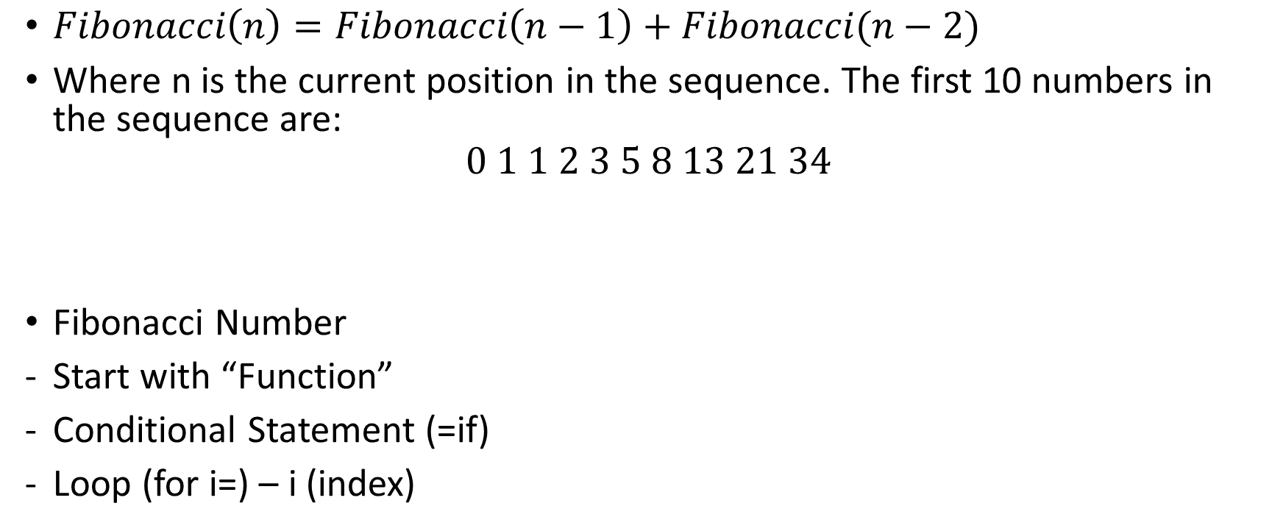
Problem 1 [Collaboration]
$Fibonacci\left(n\right)=Fibonacci\left(n−1\right)+Fibonacci(n−2)$
Where n is the current position in the sequence. The first 10 numbers in the sequence are:
$$0 1 1 2 3 5 8 13 21 34$$
Fibonacci Number
Start with “Function”
Conditional Statement (=if)
Loop (for i=) – i (index)

Slide 16

Problem 1
$Fibonacci\left(n\right)=Fibonacci\left(n−1\right)+Fibonacci(n−2)$
The first 10 numbers in the sequence are:
[$0 1 1 2 3 5 8 13 21 34$]
Fib(1)
Fib(2)
Fib(3)
Fib(4)
Fib(5)
Fib(10)

Slide 17
Problem 2 [Collaboration]
Call your function from Recitation 3 problem 1
Zeros (1,length(shearForce))
Use loop
and switch – case

Slide 18
Problem 3 [Individual]
Start with function
mod
zeros
Use for loop

